Slide 1

Restaurant & Consumer Data Analysis
- By Anil Kumar Potnuru

Slide 2
About me
Hello, my name is Anil Kumar Potnuru. I have completed my Bachelor’s degree in Computer Science and Engineering, from Gayatri vidya parishad college.
Why Data Analytics?
Honestly, I wasn’t much interested in traditional IT or coding side of computer science, but I’ve always loved working with data. Especially when I saw how data is used in real-time like in cricket and other sports create real-time insights inspired me to pursue Data Analytics as a career path.

Slide 3

Objective
  Analyze restaurant attributes, cuisines, pricing, and ratings
  Understand consumer preferences, and behavior
  Apply SQL queries: JOIN, WHERE, GROUP BY, HAVING, CTE, DERIVED TABLES
  Generate business insights for restaurant improvement

Slide 4
Dataset & Schema Overview
Restaurant Table:
Stores restaurant details (location, price, alcohol service, parking).
Key Columns: restaurant_id, name, city, price, parking.
Consumers Table:
Stores demographic & behavior info.
Key Columns: consumer_id, age, occupation, smoker, drink level, budget.
Ratings Table:
Stores ratings given by consumers to restaurants.
Columns: overall_rating, food_rating, service rating
Cuisine & Preferences:
Restaurant cuisine → restaurant cuisines.
Consumer preferences → cuisines liked by consumers.

Slide 5
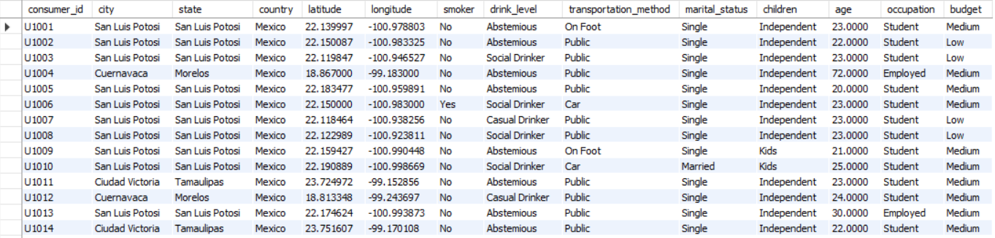
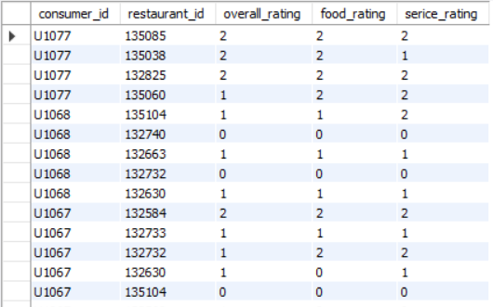
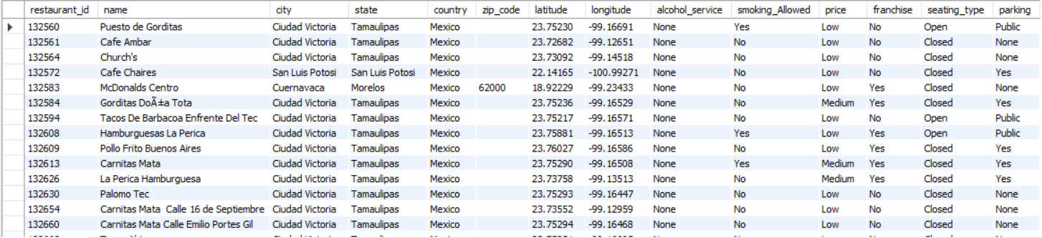
Dataset & Schema Overview
Consumers
Ratings
Consumers

Slide 6
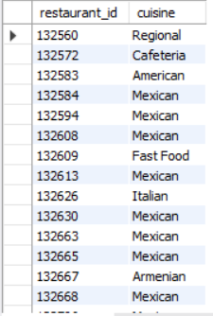
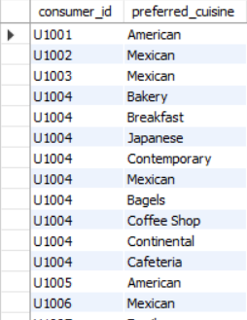
Dataset & Schema Overview
Restaurants Cuisine
Consumer Preference

Slide 7
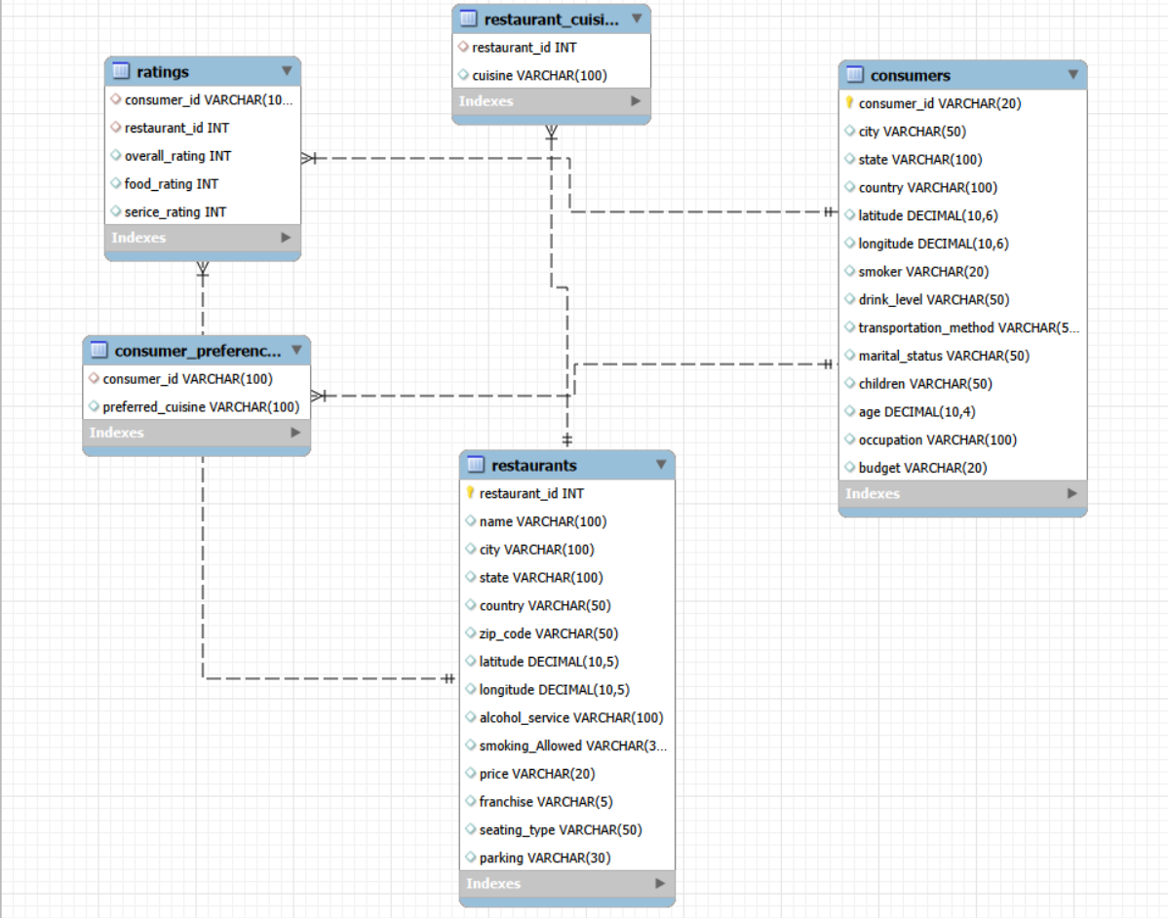
ER-Diagram overview

Slide 8
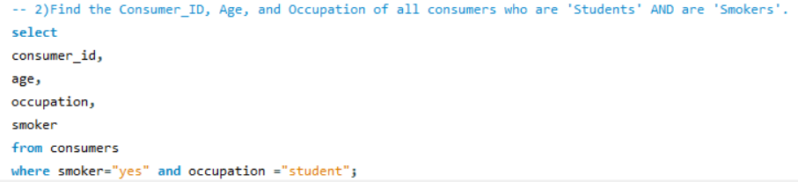
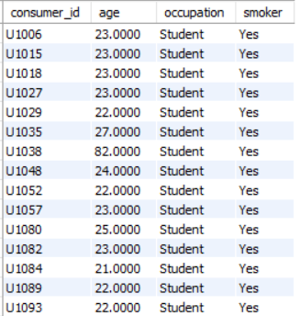
Query
Find the Consumer id, Age, and Occupation of all consumers who are ‘students’ and are ‘smokers’

Slide 9
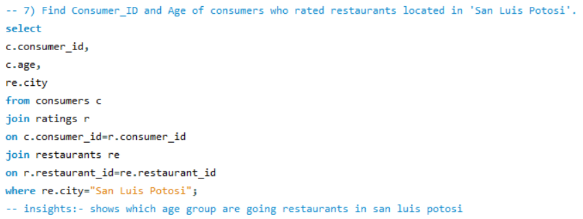
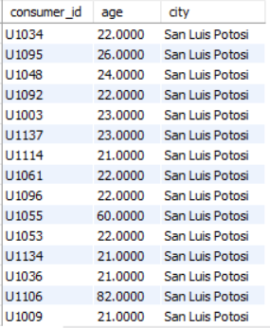
Query
Find Consumer id and Age of consumers who rated restaurants located in ‘San Luis Potosi’.

Slide 10
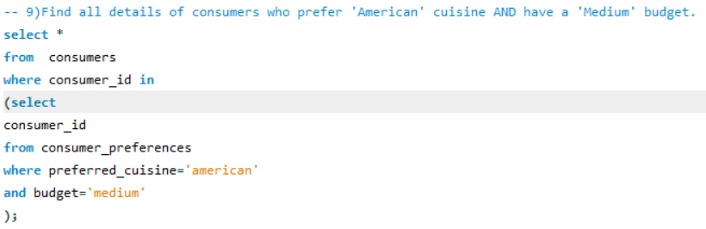
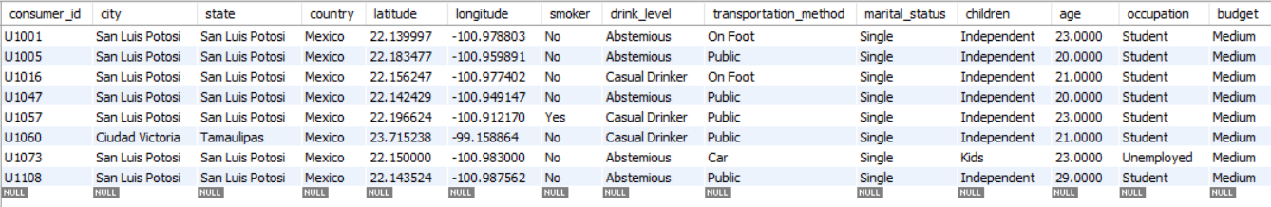
Query
Find all details of consumers who prefer ‘America’ cuisine AND have a ‘Medium’ budget.

Slide 11
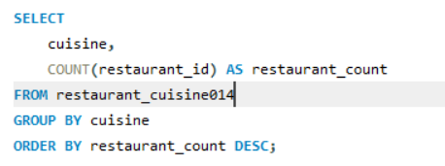
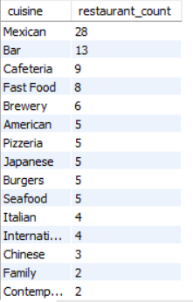
Query
Which cuisines have the highest number of restaurants?

Slide 12
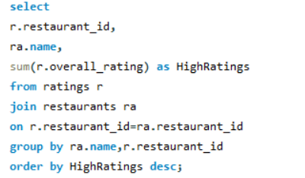
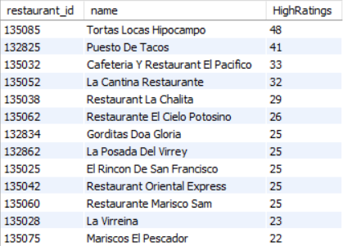
Query
Find which restaurant is having the high ratings.

Slide 13
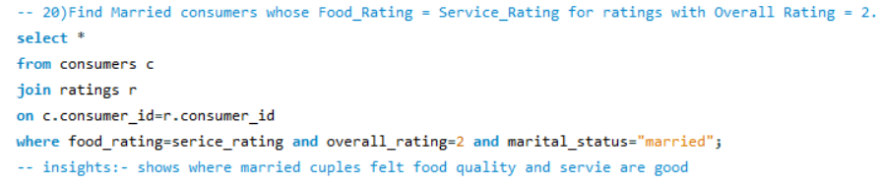
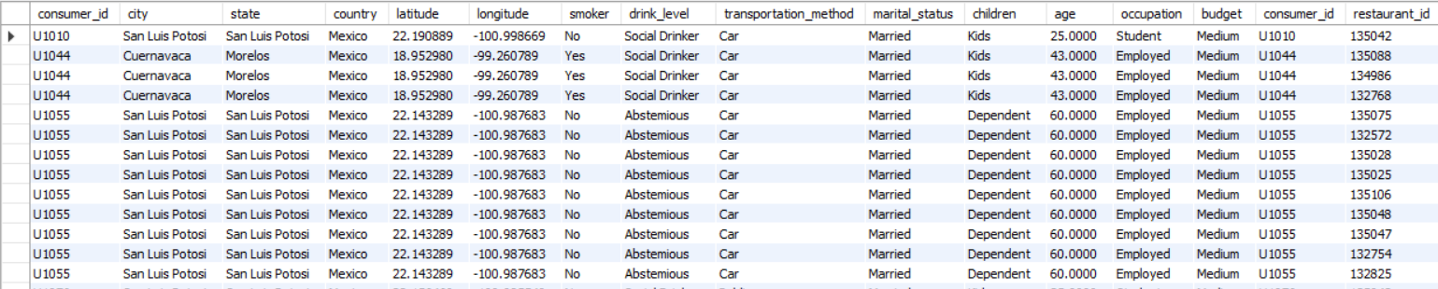
Query
Find Married consumers whose Food_rating = Service_Rating for ratings with overall Rating = 2.

Slide 14

Business Insights
  Mexican cuisine highly preferred → High demand
  Students are active reviewers → Target promotions
  Low food-rated restaurants need improvement.
  Parking availability impacts restaurant visits.
  Mid-priced restaurants with alcohol perform well.
  Tortas Locas Hipocampo is the top rated restaurant.

Slide 15

Recommendations
  Offer student combo deals & loyalty plans
  Improve food quality in low-rated restaurants
  Promote popular cuisines like Mexican/American
  Enhance parking facilities
  Expand successful franchise-style restaurants
Notes:
Offer student combo deals & loyalty plans
Improve food quality in low-rated restaurants
Promote popular cuisines like Mexican/American
Enhance parking facilities
Expand successful franchise-style restaurants

Slide 16

Conclusion
SQL analysis helped uncover clear patterns in consumer preferences and restaurant ratings.
Most popular cuisines, active customer groups, and performance gaps were identified.
Insights can guide restaurants to improve service, pricing, quality, and marketing strategies.
The project proves practical knowledge of SQL and how data can support business decision-making.

Slide 17

Experience / Challenges
  Understanding foreign-key relationships
  Optimizing JOIN queries
  Cleaning & exploring large datasets
  Mapping business questions to SQL
  Hands-on real data analysis experience

Slide 18

THANK YOU

